Slide 1
Udacity Connect Session
Session 9

Slide 2
Content
Dealing with outliers
One Hot Encoding
Feature Scaling
Train Test And Validation Split

Slide 3
Dealing with outliers

Slide 4
Dealing With Outliers
An outlier is a data point in a data set that is distant from all other observations. A data point that lies outside the overall distribution of the dataset.
Impact of outliers:
skew the data,
significant impact on mean
significant impact on standard deviation.
How to identify outliers:
using scatter plots
using the IQR interquartile range

Slide 5
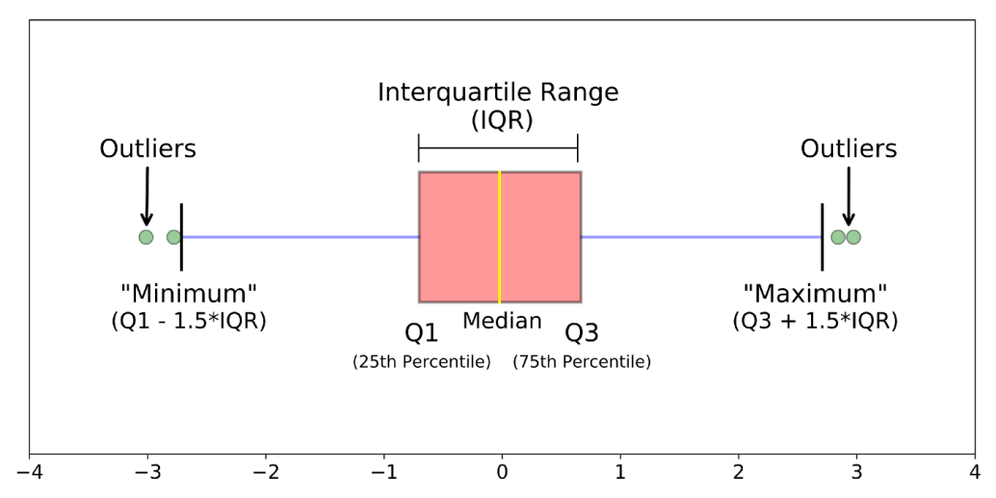
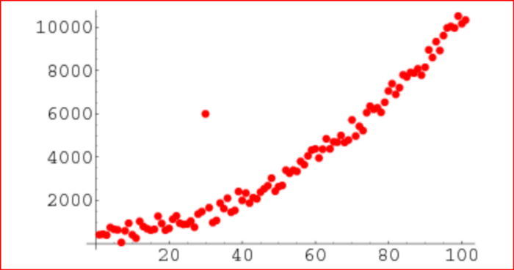
Dealing With Outliers

Slide 6
One Hot Encoding

Slide 7
One Hot Encoding
One hot encoding:
One Hot Encoding is a common way of preprocessing categorical features for machine learning models.
A machine can only understand numbers and cannot understand the text
One hot encoding can be defined as the essential process of converting the categorical data variables to be provided to machine and deep learning algorithms which in turn improve predictions as well as classification accuracy of a model.
This type of encoding creates a new binary feature for each possible category and assigns a value of 1 to the feature of each sample that corresponds to its original category.

Slide 8
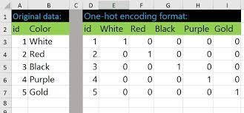


One Hot Encoding
One hot encoding using get_dummies

Slide 9
Feature Scalling

Slide 10
Feature Scaling
Say we have the following 2 features in our data
Kms driven
0
500000
Age
0
100

Slide 11
Feature Scaling
As seen multiple features can have multiple scales. Thus confusing the model and reducing its accuracy.
The solution is to perform feature scaling or standardization to all numerical features in data.

Slide 12
Feature Scaling
Now how do we perform feature scaling
Kms driven
0
1
Age
0
1

Slide 13
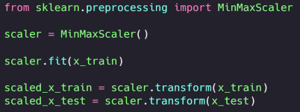
Feature Scaling
Now how do we perform feature scaling

Slide 14
Train Test Validation Split

Slide 15
Feature Scaling
Splitting the data!

Slide 16
Any Questions?

Slide 17
Thank You

